Slide 1

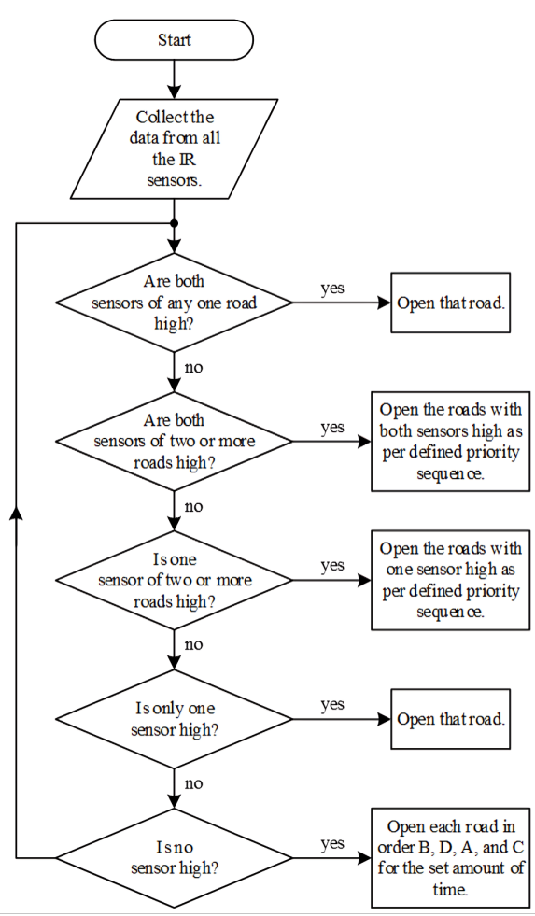
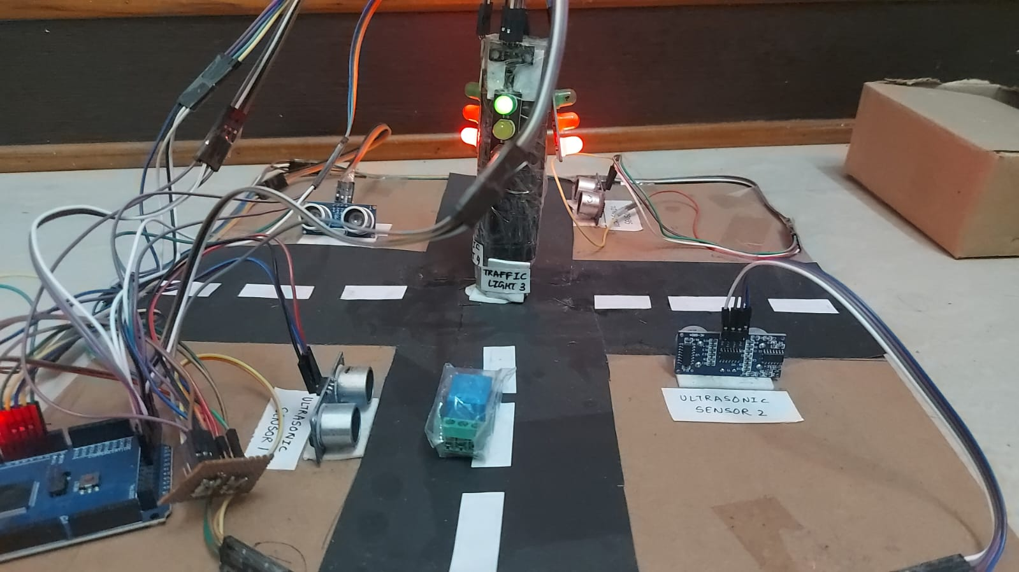
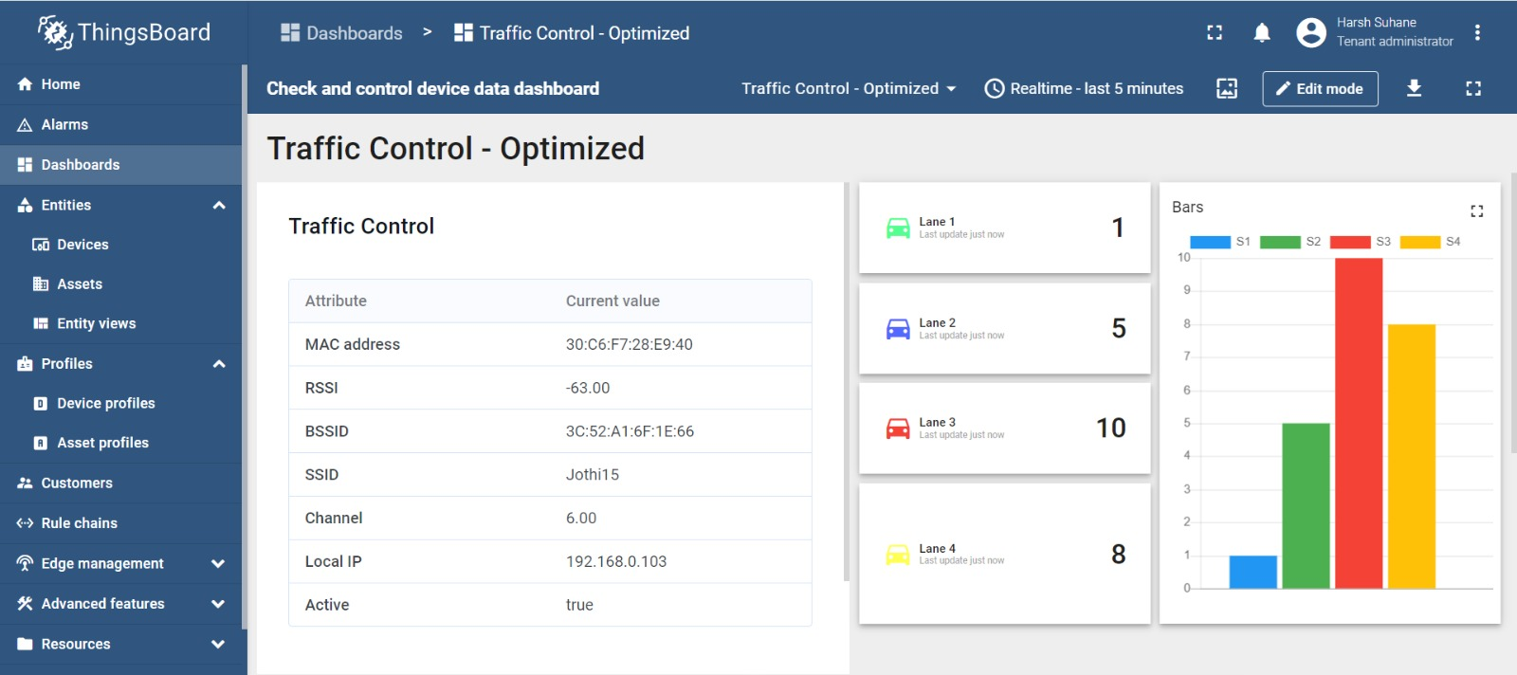
Department of computer science and Engineering
"INVATI-2024"
TITLE: AN INNOVATIVE ROAD AND TRAFFIC SAFETY MANAGEMENT SYSTEM USING IoT
ABSTRACT: The Road and Traffic Management System using IoT is a groundbreaking solution aimed at improving road and traffic management through the integration of IoT technology.
OBJECTIVES AND PROBLEM STATEMENT
PROPOSED METHODOLGY
To reduce the traffic signal time in this if in any lane the vehicle is not present then according to the traffic of other lane the traffic signal timer will adjusted.
To enhance the streetlight for energy conservation by applying solar panels and charging points for the electric vehicles.
CONTRIBUTION
Adaptively react to dynamic trafﬁc change in order to improve efﬁciency control while ensuring equity for all lanes.
RESULTS
CONCLUSION AND FUTURE WORK
APPLICATIONS
In conclusion, by harnessing the power of IoT technology, the proposed road and traffic safety management system presents a transformative solution to improve road safety outcomes. It enables real-time monitoring.
Real-Time Traffic Monitoring
Time saving
Adaptive traffic signals optimize flow promptly.

